Slide 1

SAYITNOW: SPEECH-TO-TEXT APPLICATION
Internship Member
K. Jyoshika (322103282044)
Internship Mentor
Mrs. H Gouthami .
Associate Professor
CSE(AI-ML) Department
Department of Computer Science and Engineering(AI-ML)
GAYATRI VIDYA PARISHAD COLLEGE OF ENGINEERING FOR WOMEN(A)
[Approved by AICTE NEW DELHI, Affiliated to Andhra University]
[Accredited by National Board of Accreditation (NBA) for B.Tech. CSE, ECE & IT – Valid from 2019-22 and 2022-25]
[Accredited by National Assesment and Accreditation Council(NAAC)– Valid from 2022-27]
Kommadi , Madhurawada, Visakhapatnam–530048
Academic Batch : 2024-25

Slide 2
Contents
ABSTRACT
PROBLEM STATEMENT
PROPOSED METHODOLOGY
IMPLEMENTATION
LIMITATIONS IN EXISTING SYSTEM
OUTPUT SCREENSHOTS
FUTURE SCOPE
CONCLUSION
REFERENCES

Slide 3
ABSTRACT
The "SayItNow" application represents a significant advancement in speech-to-text technology by utilizing sophisticated algorithms that convert spoken language into written text efficiently and accurately. This project aims not only to provide immediate transcription services but also to enhance accessibility for individuals who may face challenges in traditional typing methods due to physical disabilities or other barriers. Developed using Python's Streamlit framework alongside Google's powerful speech recognition API, this tool offers an intuitive interface where users can engage directly with technology through natural language processing capabilities.By integrating features such as real-time recording capabilities, dynamic visualization of sound waves, and straightforward download options for both audio recordings and transcriptions

Slide 4
PROBLEM STATEMENT
Speech recognition technology has rapidly evolved over the past few decades, becoming an integral part of various applications across different sectors
The "SayItNow" initiative was conceived from recognizing these challenges faced by many individuals who may struggle with traditional typing methods due either physical constraints or simply preference towards verbal communication styles
The primary goal is to enable users to record their voice effortlessly and receive accurate transcriptions instantly
Speech recognition systems have gained traction across various domains due largely imparting convenience when converting spoken words into written formats seamlessly
The application incorporates features such as audio visualization through waveforms, enabling users to understand their speech dynamics better

Slide 5
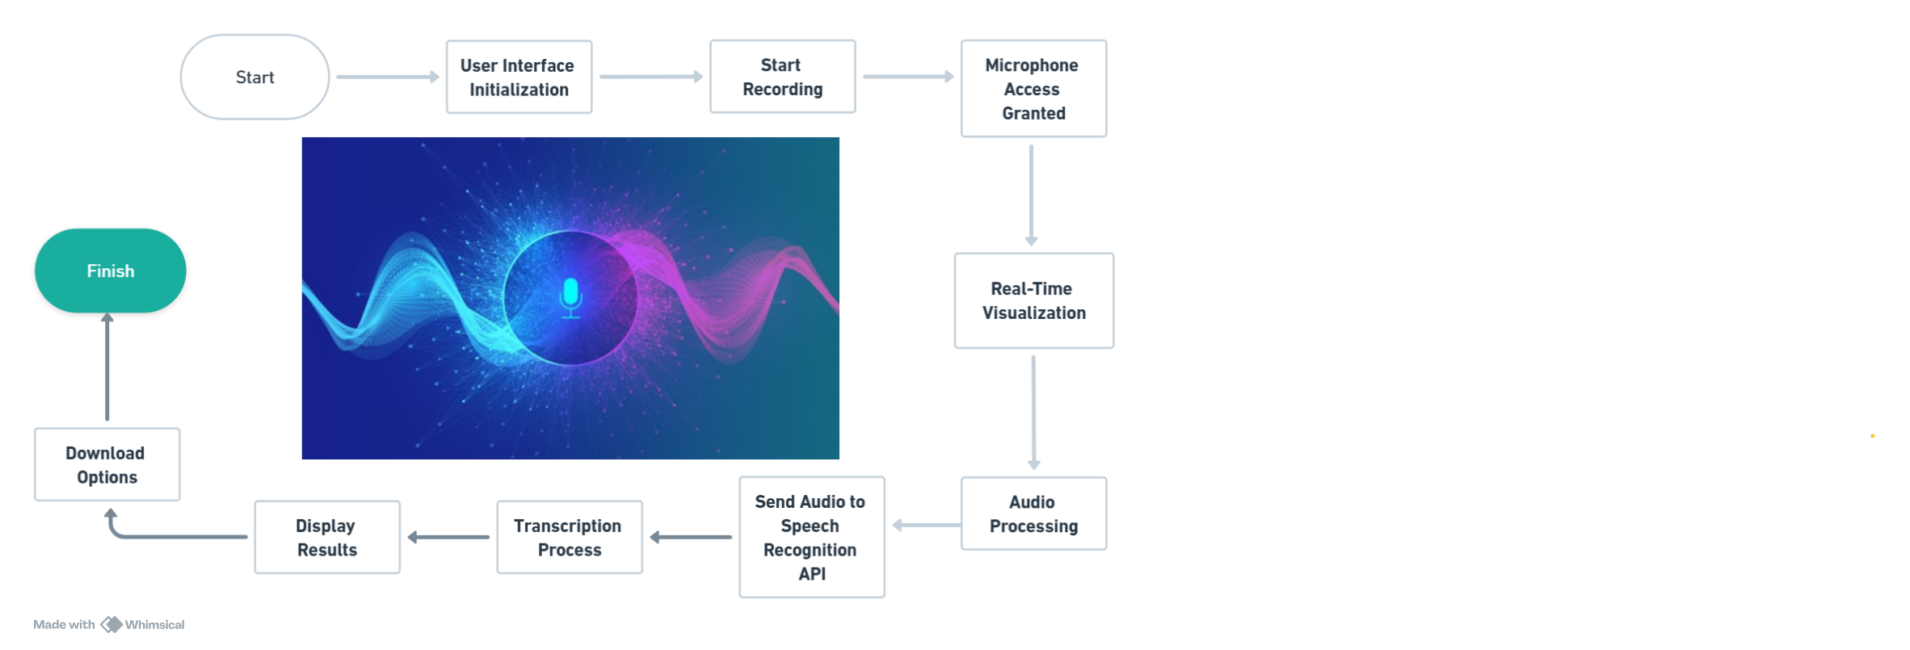
PROPOSED METHODOLOGY

Slide 6
IMPLEMENTATION
1.Workflow Overview
2.Core Components
Recording Audio
Audio Processing
Speech Recognition
3.User Interface:
4.Visualization:
5.Output Options:
6.Performance Evaluation:

Slide 7
LIMITATIONS IN EXISTING SYSTEM
Misrecognition of homophones (words that sound similar but have different meanings) can reduce the reliability of transcriptions in certain contexts.
The system heavily relies on Google's Speech Recognition API, which might introduce limitations regarding customization and dependency on external services.
The current implementation appears dependent on internet connectivity for accessing Google's API, which limits its usability in offline scenarios.
Limited Testing Scenarios
Batch: A6

Slide 8
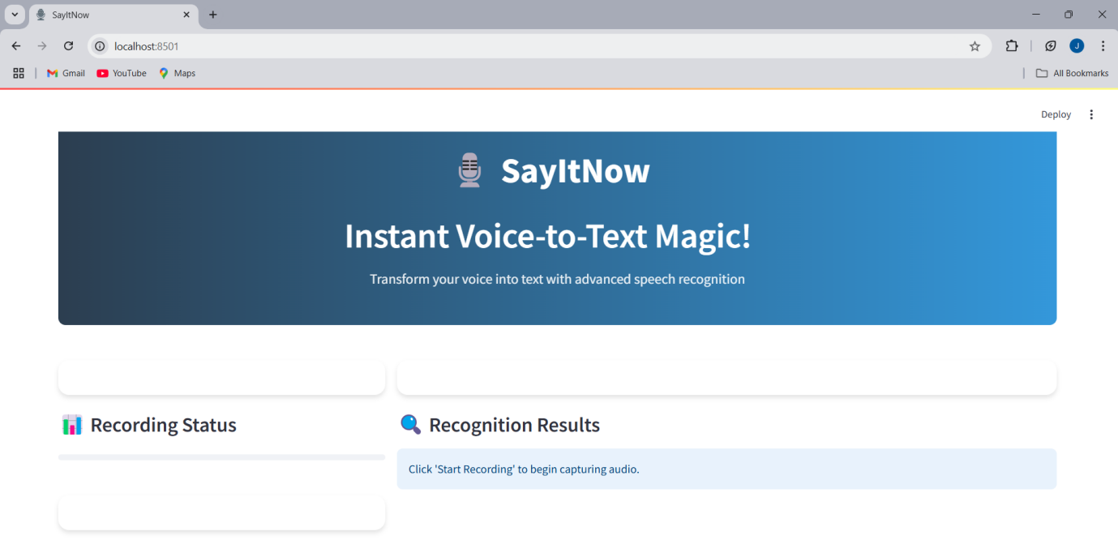

OUTPUT SCREENSHOTS
SCREENSHOT1

Slide 9
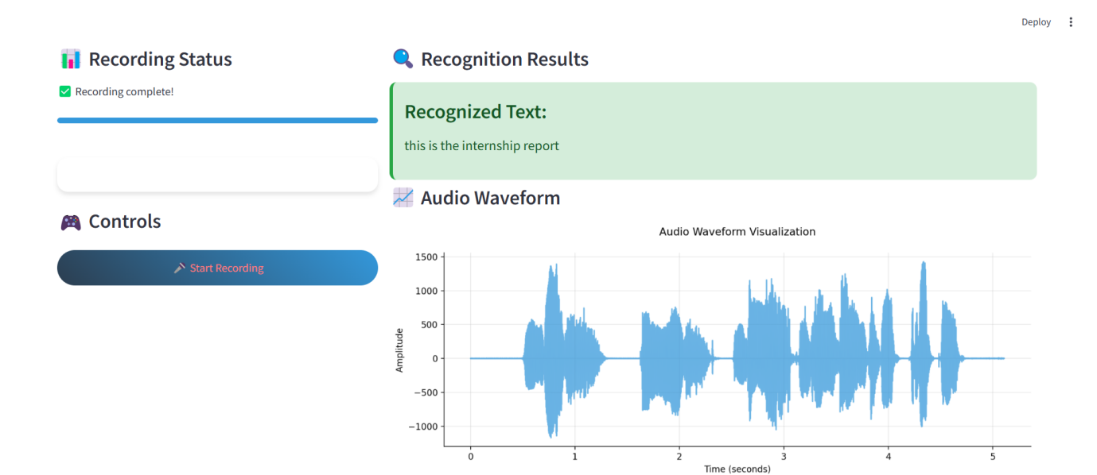

SCREENSHOT2

Slide 10
FUTURE SCOPE
Improved Accuracy:Enhanced deep learning and NLP models will improve accuracy, even in noisy environments.
Language Diversity:Support for regional dialects, accents, and low-resource languages will promote inclusivity globally.
AI Integration:Conversational AI for natural virtual assistants and emotional understanding to adapt responses based on sentiment.
Healthcare Applications:Automation of medical transcription to reduce administrative tasks.Assistive devices for individuals with disabilities.
Industry-Specific Innovations:Real-time sentiment analysis for customer support.
Transcription tools for legal and educational sectors.
Voice Biometrics:Enhancing security through voice authentication and fraud detection.

Slide 11
CONCLUSION
These innovations will bridge linguistic gaps by supporting diverse languages, dialects, and accents, fostering global inclusivity.
In healthcare, it promises to revolutionize patient care by automating time-consuming transcription tasks, enabling more efficient clinical workflows, and offering assistive technologies that empower individuals with disabilities
Personalization and security are additional dimensions that will gain prominence in the future. With the integration of voice biometrics

Slide 12
REFERENCES
1.ScienceDirect. (n.d.). Speech recognition. In Topics in Neuroscience. Retrieved December 31, 2024, from https://www.sciencedirect.com/topics/neuroscience/speech-recognition
2.Gaikwad, Santosh K., Bharti W. Gawali, and Pravin Yannawar. "A review on speech recognition technique." International Journal of Computer Applications 10.3 (2010): 16-24.
3.Shneiderman, Ben. "The limits of speech recognition." Communications of the ACM 43.9 (2000): 63-65.
4.Sheikhzadeh, Hamid, and Li Deng. "Waveform-based speech recognition using hidden filter models: Parameter selection and sensitivity to power normalization." IEEE Transactions on Speech and Audio Processing 2.1 (1994): 80-89.
5.Këpuska, Veton, and Gamal Bohouta. "Comparing speech recognition systems (Microsoft API, Google API and CMU Sphinx)." Int. J. Eng. Res. Appl 7.03 (2017): 20-24.

Slide 13
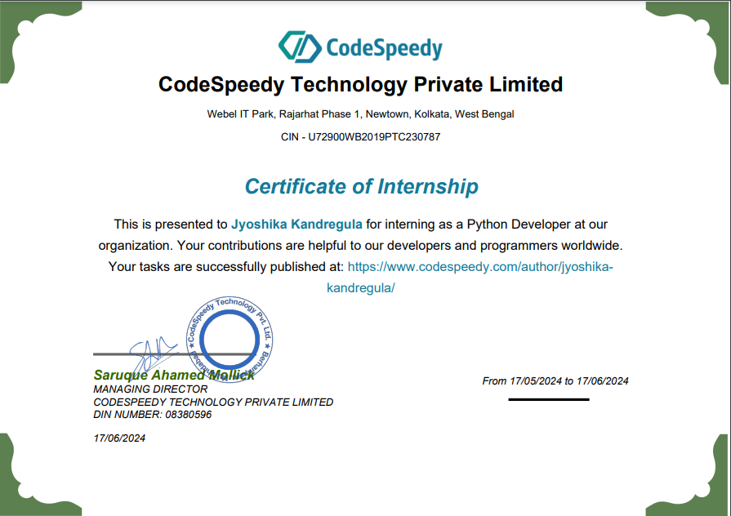
Certificate

Slide 14
Thank You Sir/Mam

